Slide 1
Linear Models and Learning via Optimization
CS771: Introduction to Machine Learning
Piyush Rai

Slide 2
Announcements
2
Quiz 1 postponed by a week (now on Aug 23)
Venue TBD, timing: 7pm, duration: 45 minutes
Syllabus will be everything up to Aug 21 class
Homework 1 released by end of this week

Slide 3
Wrapping Up Decision Trees..
3

Slide 4
Avoiding Overfitting in DTs
4
Desired: a DT that is not too big in size, yet fits the training data reasonably
Note: An example of a very simple DT is “decision-stump”
A decision-stump only tests the value of a single feature (or a simple rule)
Not very powerful in itself but often used in a large ensemble of decision stumps
Some ways to keep a DT simple enough:
Control its complexity while building the tree (stopping early)
Prune after building the tree (post-pruning)
Criteria for judging which nodes could potentially be pruned (from already built complex DT)
Use a validation set (separate from the training set)
Prune each possible node that doesn’t hurt the accuracy on the validation set
Greedily remove the node that improves the validation accuracy the most
Stop when the validation set accuracy starts worsening
A Decision Stump

Slide 5

Ensemble of Trees
5
All trees can be trained in parallel
Ensemble is a collection of models. Popular in ML
Each model makes a prediction. Take their majority as the final prediction
Ensemble of trees is a collection of simple DTs
Often preferred as compared to a single massive, complicated tree
A popular example: Random Forest (RF)
XGBoost is another popular ensemble of trees
Based on the idea of “boosting” (will study boosting later) simple trees
Sequentially trains a set of trees with each correcting errors of previous ones
Each tree is trained on a subset of the training inputs/features
An RF with 3 simple trees. The majority prediction will be the final prediction

Slide 6
Linear Models and Learning via Optimization
6

Slide 7
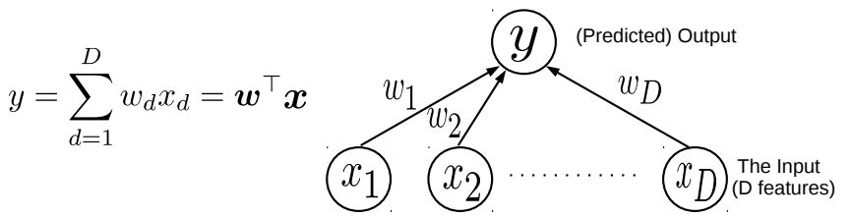

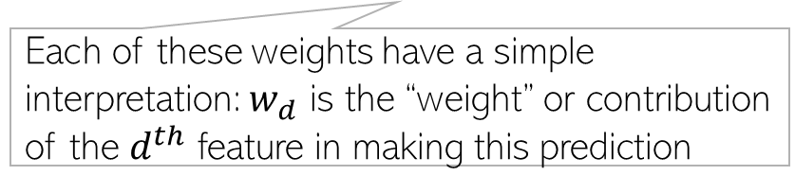
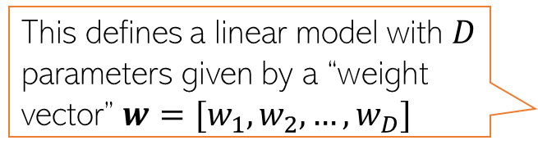
Linear Models
7
Suppose we want to learn to map inputs $x∈ℝ^{D}$ to real-valued outputs $y∈ℝ$
Linear model: Assume output to be a linear weighted combination of the $D$ input features
This simple model can be used for Linear Regression
This simple model can also be used as a “building block” for more complex models, e.g.,
Classification (binary/multiclass/multi-output/multi-label) and various other ML/deep learning models
Unsupervised learning problems (e.g., dimensionality reduction models)
This defines a linear model with $D$ parameters given by a “weight vector” $w=[w_{1},w_{2},…,w_{D}]$
Each of these weights have a simple interpretation: $w_{d}$ is the “weight” or contribution of the $d^{th}$ feature in making this prediction
The “optimal” weights are unknown and have to be learned by solving an optimization problem, using some training data

Slide 8
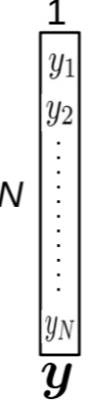
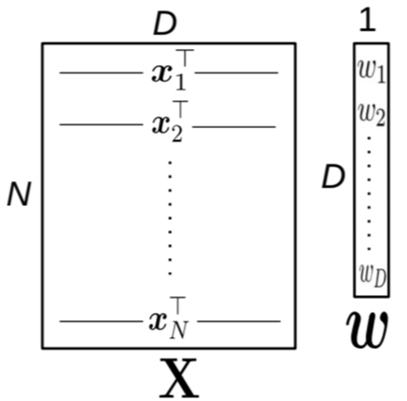
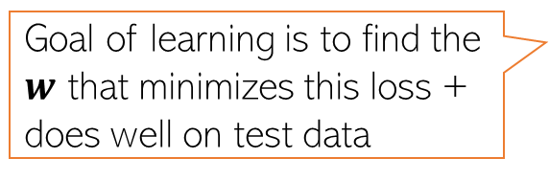
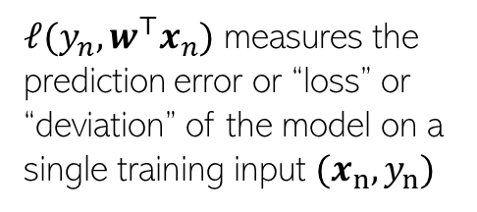
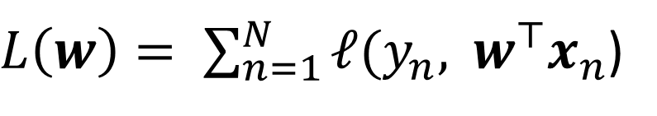
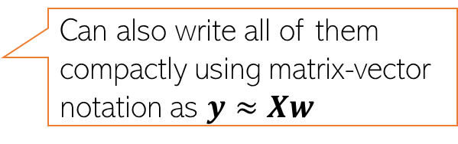

Linear Regression
8
Given: Training data with $N$ input-output pairs ${{\{(x}_{n},y_{n})\}}_{n=1}^{N}$, $x_{n}∈ℝ^{D}$, $y_{n}∈ℝ$
Goal: Learn a model to predict the output for new test inputs
Assume the function that approximates the I/O relationship to be a linear model
Let’s write the total error or “loss” of this model over the training data as
$$y_{n}≈f\left(x_{n}\right)= w^{⊤}x_{n} (n=1,2,…,N)$$
Can also write all of them compactly using matrix-vector notation as $y≈Xw$
Goal of learning is to find the $w$ that minimizes this loss + does well on test data
$L\left(w\right)= \sum_{n=1}^{N}{ℓ(y_{n}, }$ $w^{⊤}x_{n}$)
$ℓ(y_{n},w^{⊤}x_{n})$ measures the
prediction error or “loss” or “deviation” of the model on a single training input ${(x}_{n},y_{n})$
Unlike models like KNN and DT, here we have an explicit problem-specific objective (loss function) that we wish to optimize for

Slide 9
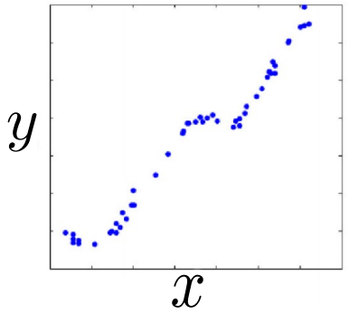
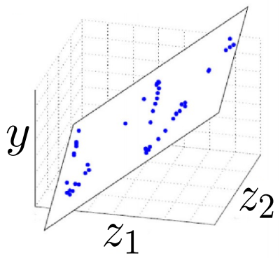
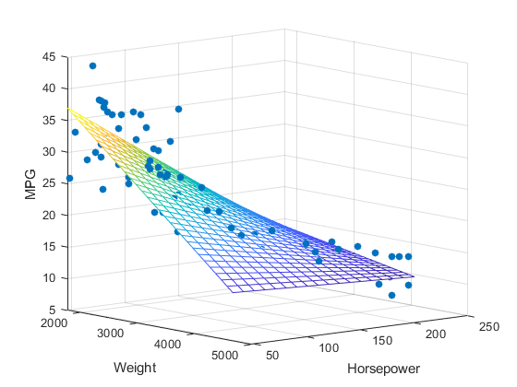




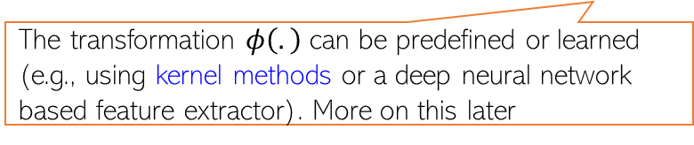

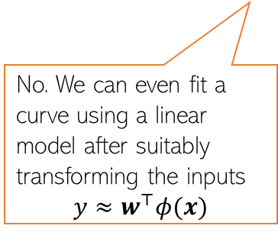
Linear Regression: Pictorially
9
Linear regression is like fitting a line or (hyper)plane to a set of points
The line/plane must also predict outputs of the unseen (test) inputs well
$$\left[\begin{aligned}z_{1} \\ z_{2}\end{aligned}\right]=φ(x)$$
What if a line/plane doesn’t model the input-output relationship very well, e.g., if their relationship is better modeled by a nonlinear curve or curved surface?
Original (single) feature
Nonlinear curve needed
Two features
Can fit a plane (linear)
(Output $y$)
(Output $y$)
Do linear models become useless in such cases?
No. We can even fit a curve using a linear model after suitably transforming the inputs
$$y≈w^{⊤}φ(x)$$
Input $x$ (single feature)
(Feature 2)
(Feature 1)
The transformation $φ\left(.\right)$ can be predefined or learned (e.g., using kernel methods or a deep neural network based feature extractor). More on this later

Slide 10
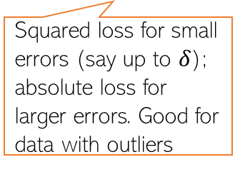


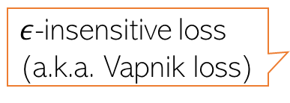









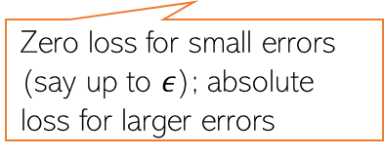
Loss Functions for Regression
10
Choice of loss function usually depends on the nature of the data. Also, some loss functions result in easier optimization problem than others
Many possible loss functions for regression problems
Squared loss
Loss
$${(y_{n}−f(x_{n}))}^{2}$$
Absolute loss
Loss
$${|y}_{n}−f\left(x_{n}\right)|$$
Very commonly used for regression. Leads to an easy-to-solve optimization problem
Grows more slowly than squared loss. Thus better suited when data has some outliers (inputs on which model makes large errors)
${y_{n}− f(x}_{n}$)
${y_{n}− f(x}_{n}$)
Loss
Huber loss
Loss
$${|y}_{n}−f\left(x_{n}\right)|−ε$$
Squared loss for small errors (say up to $δ$); absolute loss for larger errors. Good for data with outliers
$ε$-insensitive loss
(a.k.a. Vapnik loss)
Note: Can also use squared loss instead of absolute loss
Zero loss for small errors (say up to $ε$); absolute loss for larger errors
$$−δ$$
$$δ$$
${y_{n}− f(x}_{n}$)
$$−ε$$
$$ε$$
${y_{n}− f(x}_{n}$)

Slide 11
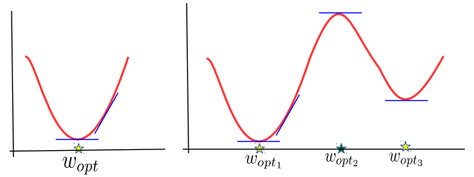
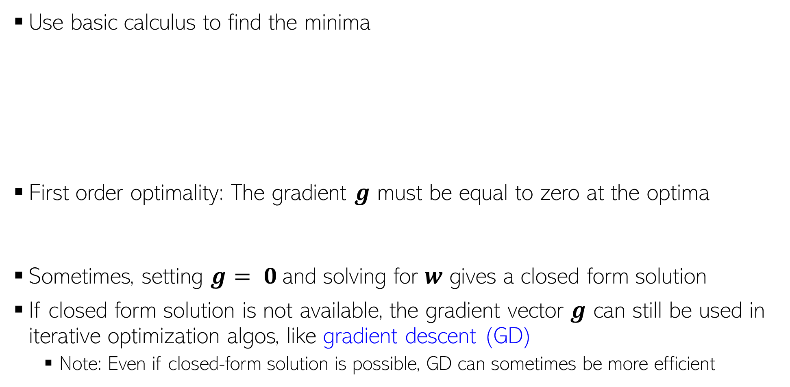
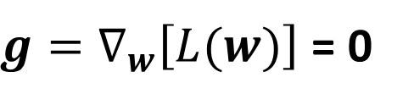
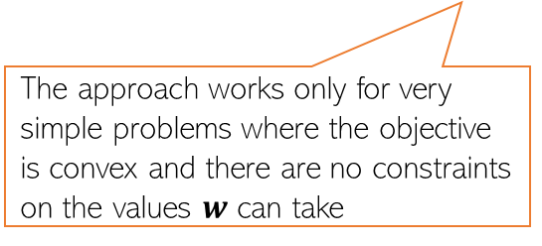
Minimizing Loss Func using First-Order Optimality
Use basic calculus to find the minima
First order optimality: The gradient $g$ must be equal to zero at the optima
Sometimes, setting $g$ $= 0$and solving for $w$ gives a closed form solution
If closed form solution is not available, the gradient vector $g$ can still be used in iterative optimization algos, like gradient descent (GD)
Note: Even if closed-form solution is possible, GD can sometimes be more efficient
Called “first order” since only gradient is used and gradient provides the first order info about the function being optimized
The approach works only for very simple problems where the objective is convex and there are no constraints on the values $w$ can take
$g=∇_{w}\left[L(w)\right]$ = 0

Slide 12



Minimizing Loss Func. using Iterative Optimization
Can I used this approach to solve maximization problems?
For max. problems we can use gradient ascent
$$w^{(t+1)}= w^{(t)}+η_{t}g^{(t)}$$
Iterative since it requires several steps/iterations to find the optimal solution
Fact: Gradient gives the direction of steepest change in function’s value
Will move in the direction of the gradient
For convex functions, GD will converge to the global minima
Good initialization needed for non-convex functions
Gradient Descent
The learning rate very imp. Should be set carefully (fixed or chosen adaptively). Will discuss some strategies later
Initialize $w$ as $w^{(0)}$
For iteration $t=0,1,2,…$(or until convergence)
Calculate the gradient $g^{(t)}$using the current iterates $w^{(t)}$
Set the learning rate $η_{t}$
Move in the opposite direction of gradient
Sometimes may be tricky to to assess convergence. Will see some methods later
$$w^{(t+1)}= w^{(t)}−η_{t}g^{(t)}$$

Slide 13

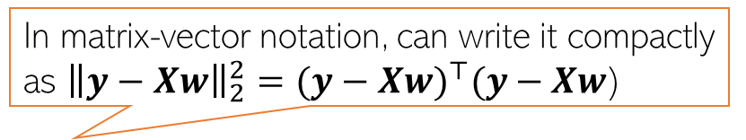
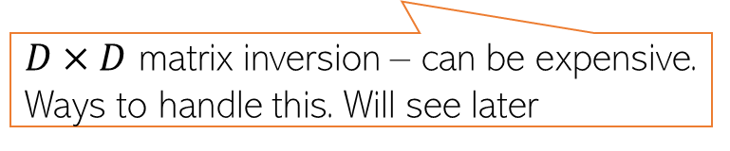
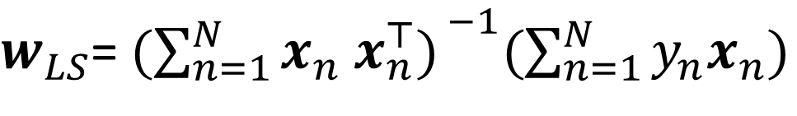


Linear Regression with Squared Loss
13
In matrix-vector notation, can write it compactly as ${\left\|y−Xw\right\|}_{2}^{2}={(y−Xw)}^{⊤}(y−Xw$)
In this case, the loss func will be
Let us find the $w$that optimizes (minimizes) the above squared loss
Let’s use first order optimality
The LS problem can be solved easily and has a closed form solution
$L\left(w\right)=$ $\sum_{n=1}^{N}{{(y_{n}−w^{⊤}x_{n})}^{2}}$
The “least squares” (LS) problem Gauss-Legendre, 18th century)
Closed form solutions to ML problems are rare.
$w_{LS}$= ${\text{arg} \text{min}}_{w} L\left(w\right)={\text{arg} \text{min}}_{w}\sum_{n=1}^{N}{{(y_{n}−w^{⊤}x_{n})}^{2}}$
$w_{LS}$= ${(\sum_{n=1}^{N}{x_{n} x_{n}^{⊤}) }}^{−1}(\sum_{n=1}^{N}{y_{n}x_{n}})$
$${=(X^{⊤}X)}^{−1}X^{⊤}y$$
$D×D$ matrix inversion – can be expensive. Ways to handle this. Will see later

Slide 14

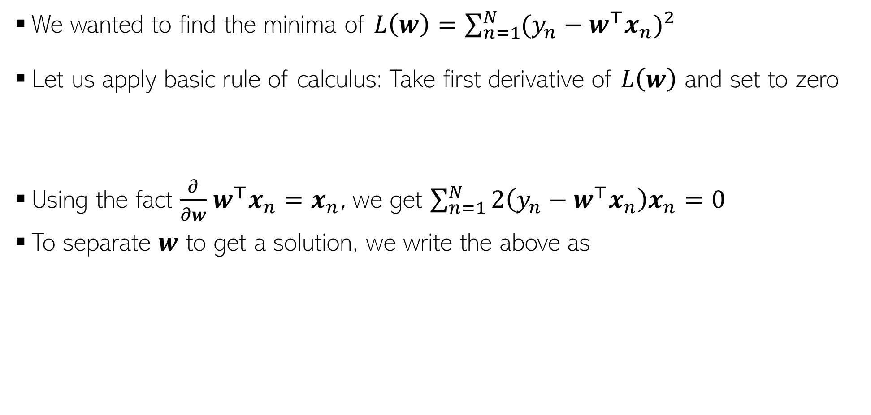
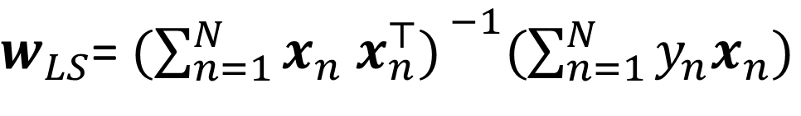

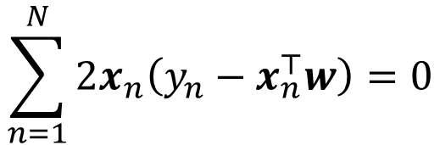

Proof: A bit of calculus/optim. (more on this later)
14
We wanted to find the minima of $L\left(w\right)=\sum_{n=1}^{N}{{(y_{n}−w^{⊤}x_{n})}^{2}}$
Let us apply basic rule of calculus: Take first derivative of $L\left(w\right)$ and set to zero
Using the fact $\frac{∂}{∂w}$ $w^{⊤}x_{n}=x_{n}$, we get $\sum_{n=1}^{N}{2\left(y_{n}−w^{⊤}x_{n}\right)x_{n}=0}$
To separate $w$ to get a solution, we write the above as
Chain rule of calculus
$\frac{∂L\left(w\right)}{∂w}=\frac{∂}{∂w}$ $\sum_{n=1}^{N}{{(y_{n}−w^{⊤}x_{n})}^{2}}=\sum_{n=1}^{N}{2\left(y_{n}−w^{⊤}x_{n}\right)\frac{∂}{∂w}}\left(y_{n}−w^{⊤}x_{n}\right)=0$
Partial derivative of dot product w.r.t each element of $w$
Result of this derivative is $x_{n}$ - same size as $w$
$$\sum_{n=1}^{N}{2x_{n}\left(y_{n}−x_{n}^{⊤}w\right)=0}$$
$$\sum_{n=1}^{N}{y_{n}x_{n}−x_{n}x_{n}^{⊤}w=0}$$
$w_{LS}$= ${(\sum_{n=1}^{N}{x_{n} x_{n}^{⊤}) }}^{−1}(\sum_{n=1}^{N}{y_{n}x_{n}})$
$${=(X^{⊤}X)}^{−1}X^{⊤}y$$

Slide 15
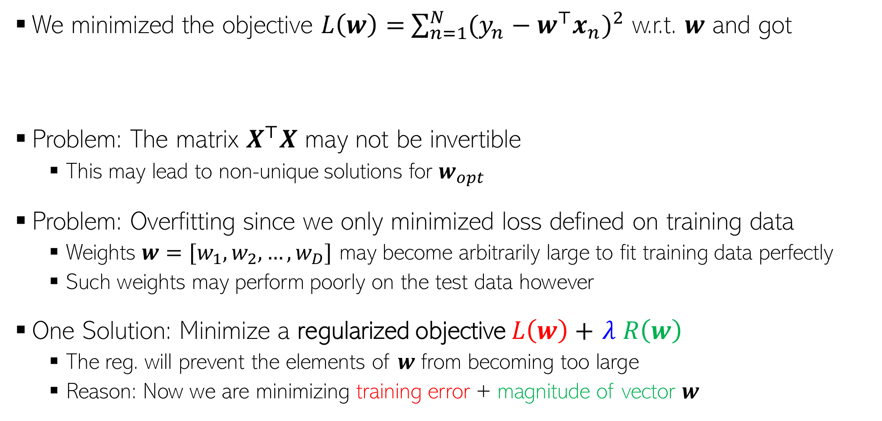
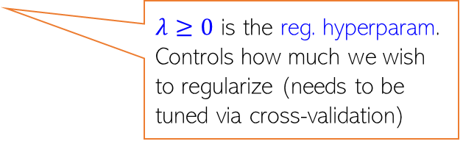
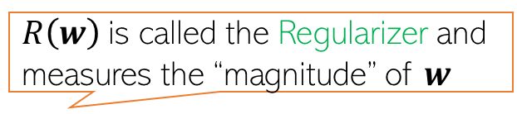

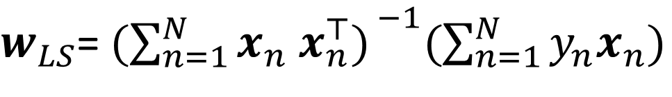
Problem(s) with the Solution!
15
We minimized the objective $L\left(w\right)=$ $\sum_{n=1}^{N}{{(y_{n}−w^{⊤}x_{n})}^{2}}$ w.r.t. $w$ and got
Problem: The matrix $X^{⊤}X$ may not be invertible
This may lead to non-unique solutions for $w_{opt}$
Problem: Overfitting since we only minimized loss defined on training data
Weights $w=[w_{1},w_{2},…,w_{D}]$ may become arbitrarily large to fit training data perfectly
Such weights may perform poorly on the test data however
One Solution: Minimize a regularized objective $L\left(w\right)+$ $λ R\left(w\right)$
The reg. will prevent the elements of $w$ from becoming too large
Reason: Now we are minimizing training error + magnitude of vector $w$
$w_{LS}$= ${(\sum_{n=1}^{N}{x_{n} x_{n}^{⊤}) }}^{−1}(\sum_{n=1}^{N}{y_{n}x_{n}})$
$${=(X^{⊤}X)}^{−1}X^{⊤}y$$
$R\left(w\right)$is called the Regularizer and measures the “magnitude” of $w$
$λ≥0$ is the reg. hyperparam. Controls how much we wish to regularize (needs to be tuned via cross-validation)

Slide 16


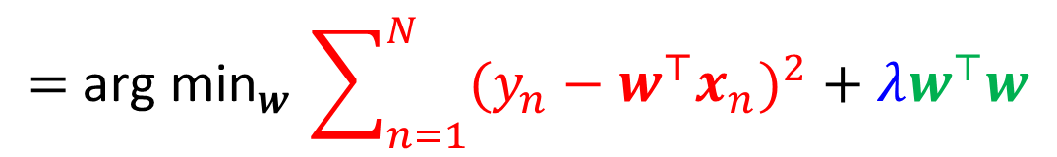
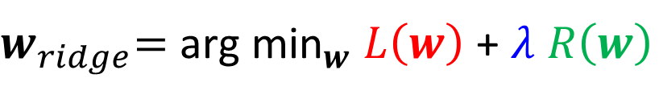
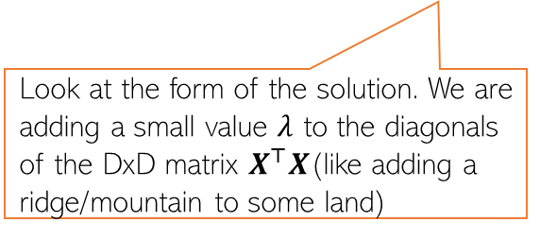

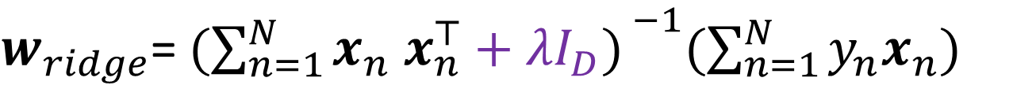
Regularized Least Squares (a.k.a. Ridge Regression)
Recall that the regularized objective is of the form $L_{reg}(w)= L\left(w\right)+λ R\left(w\right)$
One possible/popular regularizer: the squared Euclidean ($ℓ_{2}$ squared) norm of $w$
With this regularizer, we have the regularized least squares problem as
Proceeding just like the LS case, we can find the optimal $w$ which is given by
$$R\left(w\right)= {\left\|w\right\|}_{2}^{2}= w^{⊤}w$$
Look at the form of the solution. We are adding a small value $λ$ to the diagonals of the DxD matrix $X^{⊤}X$(like adding a ridge/mountain to some land)
$w_{ridge}\text{=} {\text{arg} \text{min}}_{w} L\left(w\right)$ + $λ R\left(w\right)$
$${\text{= }\text{arg} \text{min}}_{w}\sum_{n=1}^{N}{{(y_{n}−w^{⊤}x_{n})}^{2}}+λw^{⊤}w$$
Why is the method called “ridge” regression
$w_{ridge}$= ${(\sum_{n=1}^{N}{x_{n} x_{n}^{⊤}+λI_{D}) }}^{−1}(\sum_{n=1}^{N}{y_{n}x_{n}})$
$${=(X^{⊤}X+λI_{D})}^{−1}X^{⊤}y$$

Slide 17

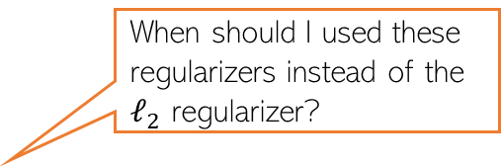
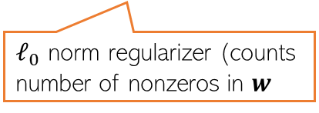



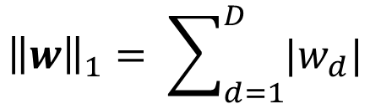
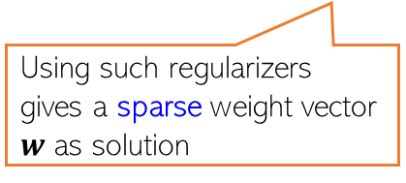
Other Ways to Control Overfitting
Note that optimizing loss functions with such regularizers is usually harder than ridge reg. but several advanced techniques exist (we will see some of those later)
Use a regularizer $R\left(w\right)$ defined by other norms, e.g.,
Use non-regularization based approaches
Early-stopping (stopping training just when we have a decent val. set accuracy)
Dropout (in each iteration, don’t update some of the weights)
Injecting noise in the inputs
$ℓ_{1}$ norm regularizer
Use them if you have a very large number of features but many irrelevant features. These regularizers can help in automatic feature selection
$${\left\|w\right\|}_{1}= \sum_{d=1}^{D}{|w_{d}|}$$
When should I used these regularizers instead of the $ℓ_{2}$ regularizer?
$${\left\|w\right\|}_{0}=\#nnz(w)$$
Using such regularizers gives a sparse weight vector $w$ as solution
sparse means many entries in $w$ will be zero or near zero. Thus those features will be considered irrelevant by the model and will not influence prediction
Automatic feature selection? Wow, cool!!!
But how exactly?
$ℓ_{0}$ norm regularizer (counts number of nonzeros in $w$
All of these are very popular ways to control overfitting in deep learning models. More on these later when we talk about deep learning

Slide 18

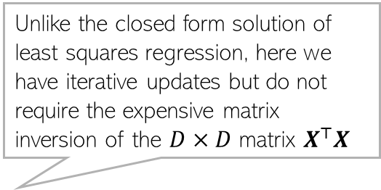
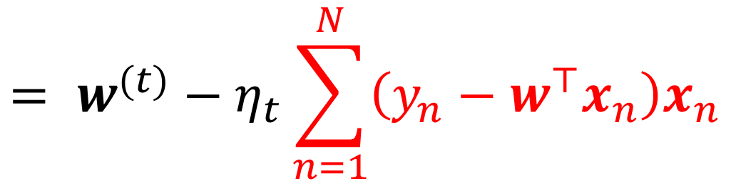
Gradient Descent for Linear/Ridge Regression
Just use the GD algorithm with the gradient expressions we derived ☺
Iterative updates for linear regression will be of the form
Similar updates for ridge regression as well (with the gradient expression being slightly different; left as an exercise)
More on iterative optimization methods later
Unlike the closed form solution of least squares regression, here we have iterative updates but do not require the expensive matrix inversion of the $D×D$ matrix $X^{⊤}X$
$$w^{(t+1)}= w^{(t)}−η_{t}g^{\left(t\right)}$$
$$= w^{(t)}−η_{t}\sum_{n=1}^{N}{\left(y_{n}−w^{⊤}x_{n}\right)x_{n}}$$

